Slide 1



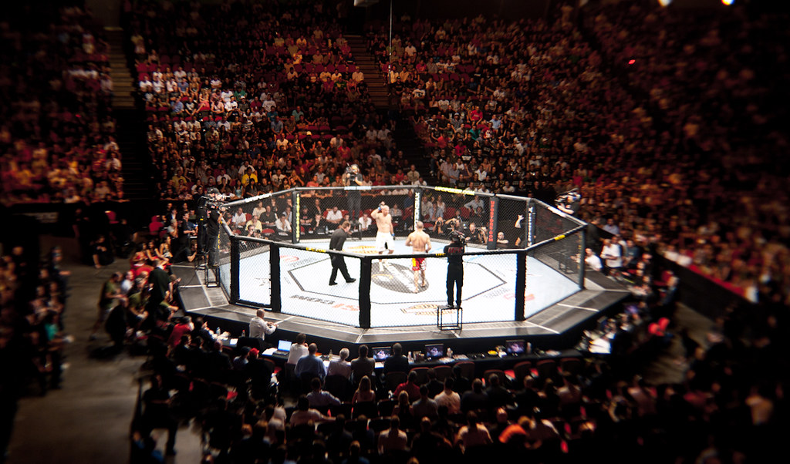

Predicting UFC Fight Outcomes with Machine Learning
Team 11:
Amaz Salman 24001042 – Data and Prediction modelling
Forest Bennett 23010240 – Data Acquisition, Engineering and Presentation
Karolina Cardenas 20014550 – Data Acquisition, Front end design and build.
Daniel Soung-Yun Kim 24016358 – Data and Prediction modelling
Who will win: Holloway or Poirier?
This Photo by Unknown Author is licensed under CC BY-NC-ND

Slide 2
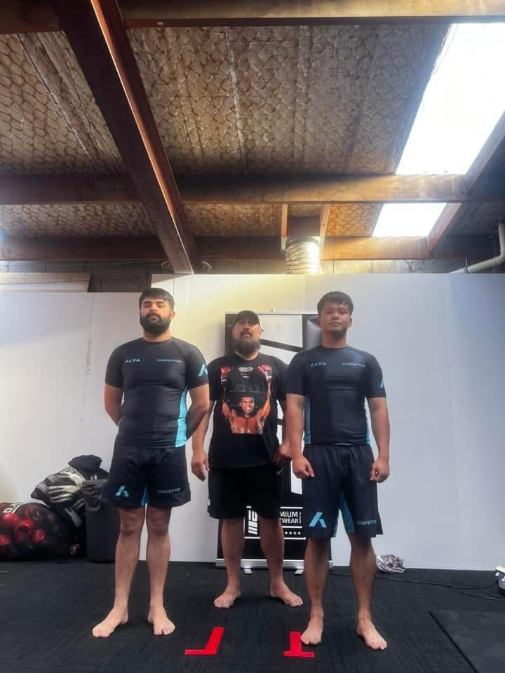
Why predict UFC fights?
Can make a person a lot of money if they predict the right winner.
Help sponsors to put their money behind someone who is predicted to win.
Helps fans to learn get deeper understanding of the sport.
Helps train and test prediction models.
The question is: Can we predict the winner of a UFC fight just using fighter statistics?
Amaz Salman

Slide 3
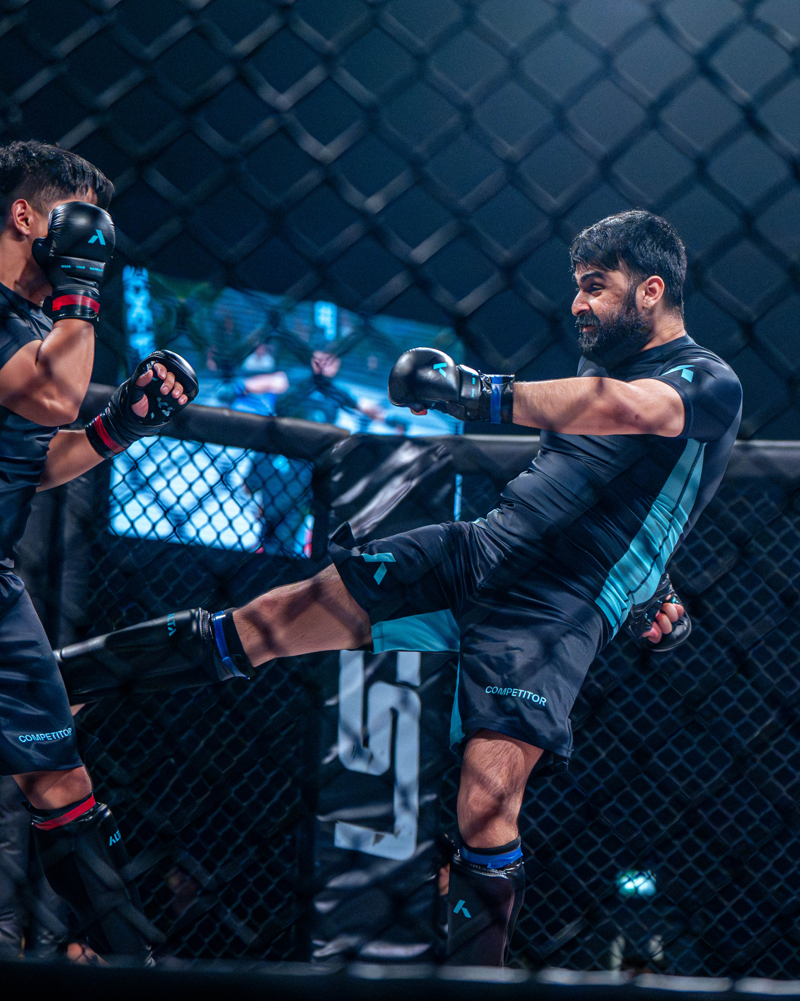
Why predictions are useful
UFC and MMA betting has experienced a growth in recent years due to an increase in interest of combat sports.
In 2021 MMA global betting market was valued at $1.8 billion which is an increase compared to the market value of $1.4 billion in 2020.
The clear increase in interest of combat sports and betting on combat sports gives us a clear indication that it is a growing field.
Furthermore, with this increase in interests it can be assumed that people participating in sports betting would want reliable prediction software to further improve their chances of walking away with wins.
Amaz Salman

Slide 4
Data:
Data for fights was acquired using the API from the following site: https://console.sportradar.com/. And for fighters was scraping from http://www.ufcstats.com/statistics/fighters?char={}&page=all
The data included the following for the match data: Match date, competition, final round, final round length, method, scheduled length and weight class.
For the fighters (winner and loser in each match) the following stats was captured: Name, ID, Abbreviation(Names Abbreviation), Gender, qualifier, control, knockdowns, significant strike percentage, significant strikes, significant strikes attempted, submission attempts, takedown percentage, takedowns, takedowns attempted, total strike percentage, total strikes and total strikes attempted.
An additional dataframe was created just for the basic stats of fighters such as: Name, Height, weight, ranking etc. This was created for the frontend.
Forest Bennett

Slide 5
Feature Engineering:
The data for all the fights was stored in a dataframe.
Duplicate fights were then removed.
Using the following columns for winner and loser, additional columns were created: significant strike percentage, total strike percentage, knockdowns, takedown percentage, takedowns and submission attempts.
Additional columns created: strike_accuracy_diff, total_strike_accuracy_diff, knockdowns_diff, takedown_accuracy_diff, takedowns_diff, submission_attempts_diff.
These additional columns were then utilised to create prediction models.
Forest Bennett

Slide 6
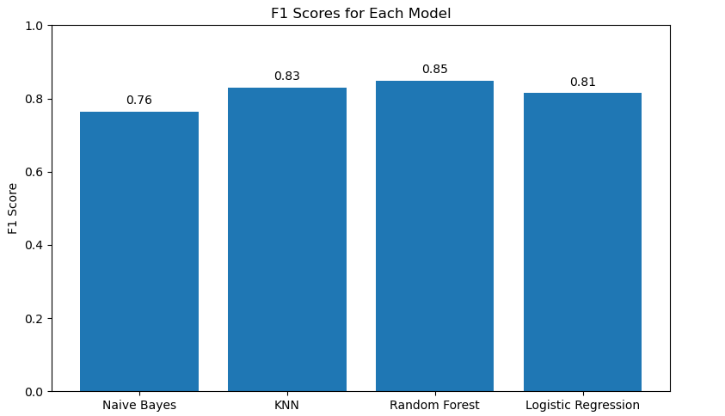

Modeling Strategy:
Average F1 across models: 0.81. Best performer: Random Forest, F1 = 0.85
-Fight stats were used to create prediction models.
-The stats used included: strike_accuracy_diff, total_strike_accuracy_diff, knockdowns_diff, takedown_accuracy_diff, takedowns_diff, submission_attempts_diff, weight_class, and method.
-These stats were used to create the following models: Naïve Bayers, KNN Random Forest and Logistic Regression.
-All F1 scores for the models were high but the highest score was for Random Forest, which scored 0.843.
Daniel Soung-Yun Kim

Slide 7
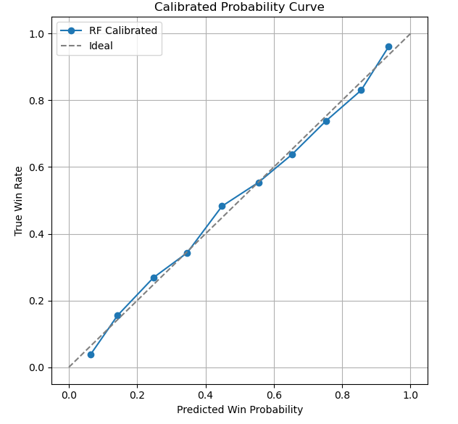
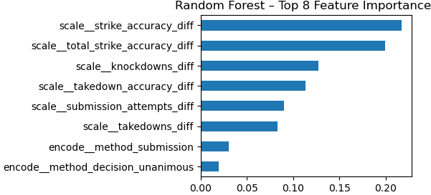
What we found:
Calibration converts those raw scores into actionable probabilities with a Brier of 0.12
Features that mattered the most were: Strike Accuracy, Knockdowns, Takedown Accuracy.
Daniel Soung-Yun Kim

Slide 8
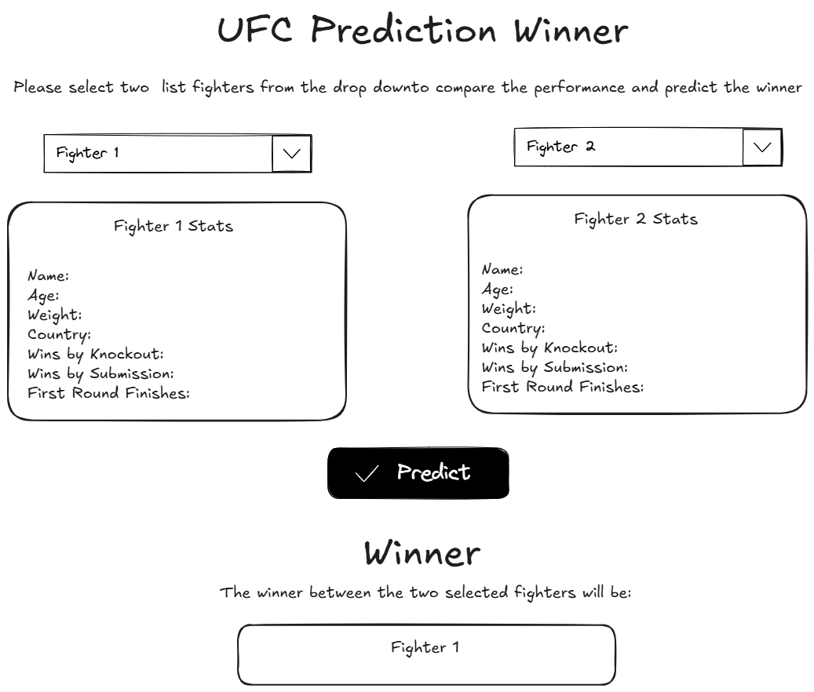
Mockup

Slide 9
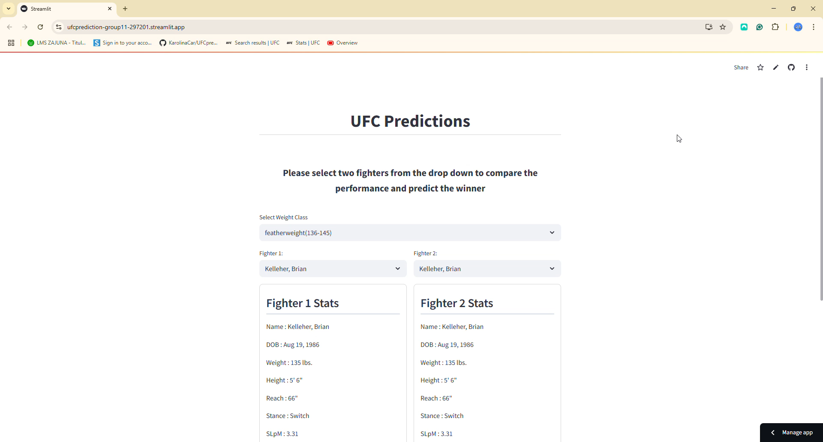
Demo

Slide 10
Conclusion:
Predicting the winner of UFC fights can be accomplished to an extent. With a high score of 0.85 on prediction models Random Forest gives the best predictions. Whilst this is a high score, it would have been more beneficial if the prediction models could be tested in real world scenarios. This can maybe be done in the future. In addition to this, more fighter data may provide better prediction models. This could include the results of the fighters last 5 fights, their age, experience and current rank.
Karolina Cardenas

